Slide 1
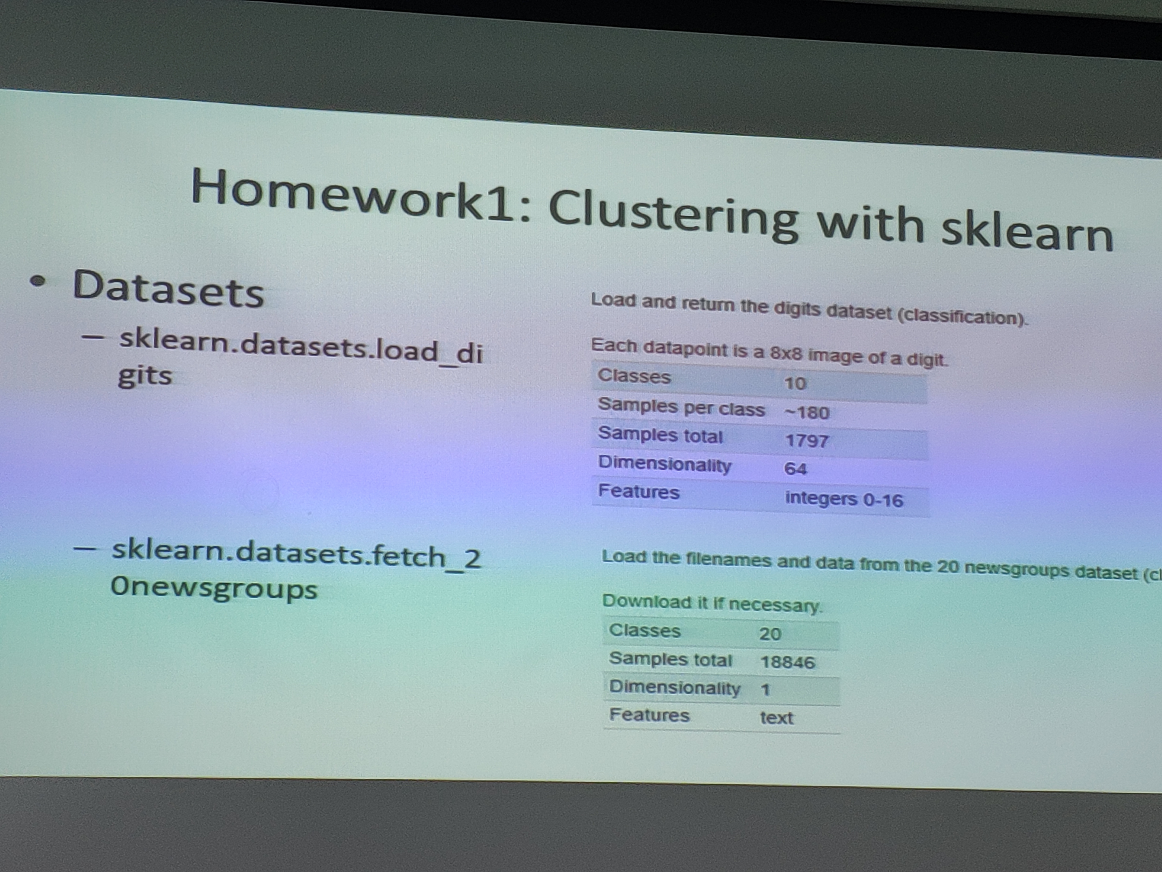

Slide 2
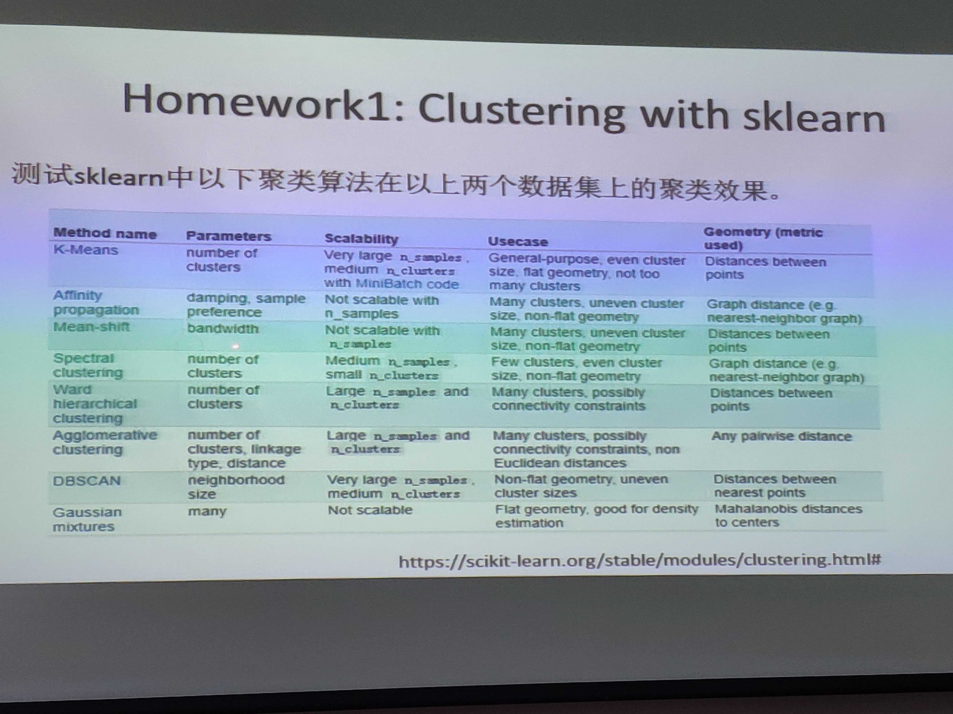

Slide 3
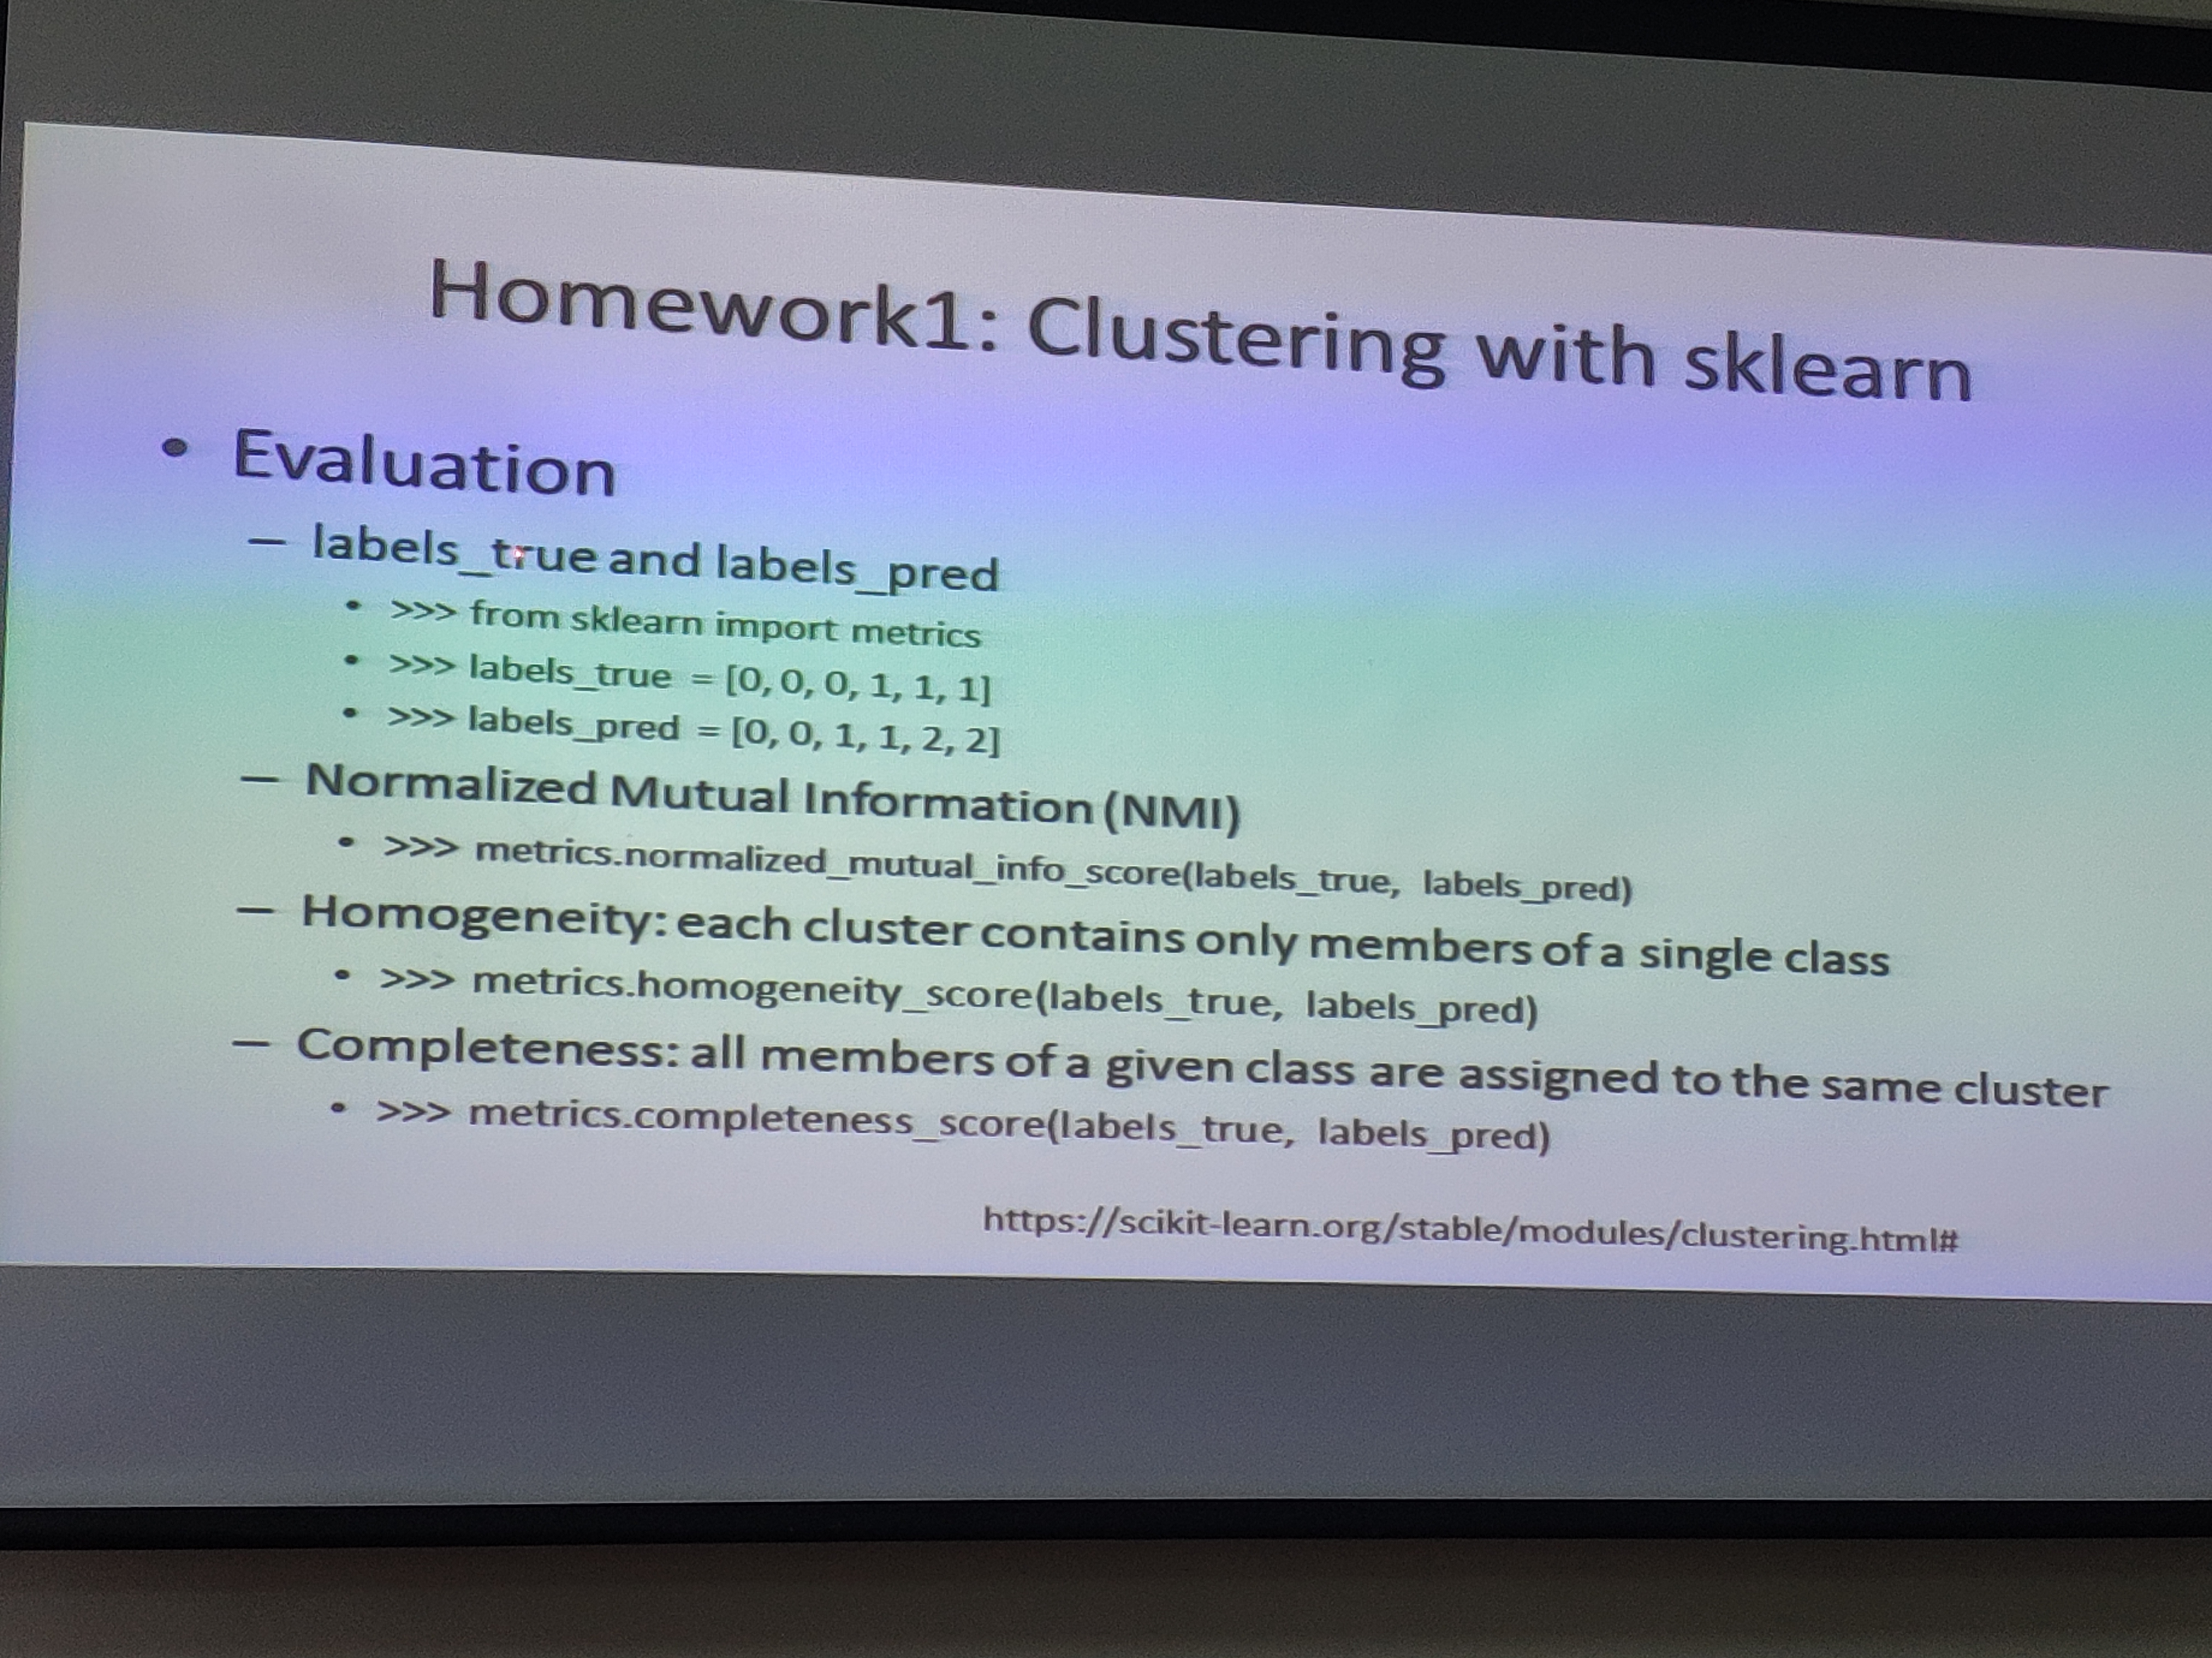

Slide 4
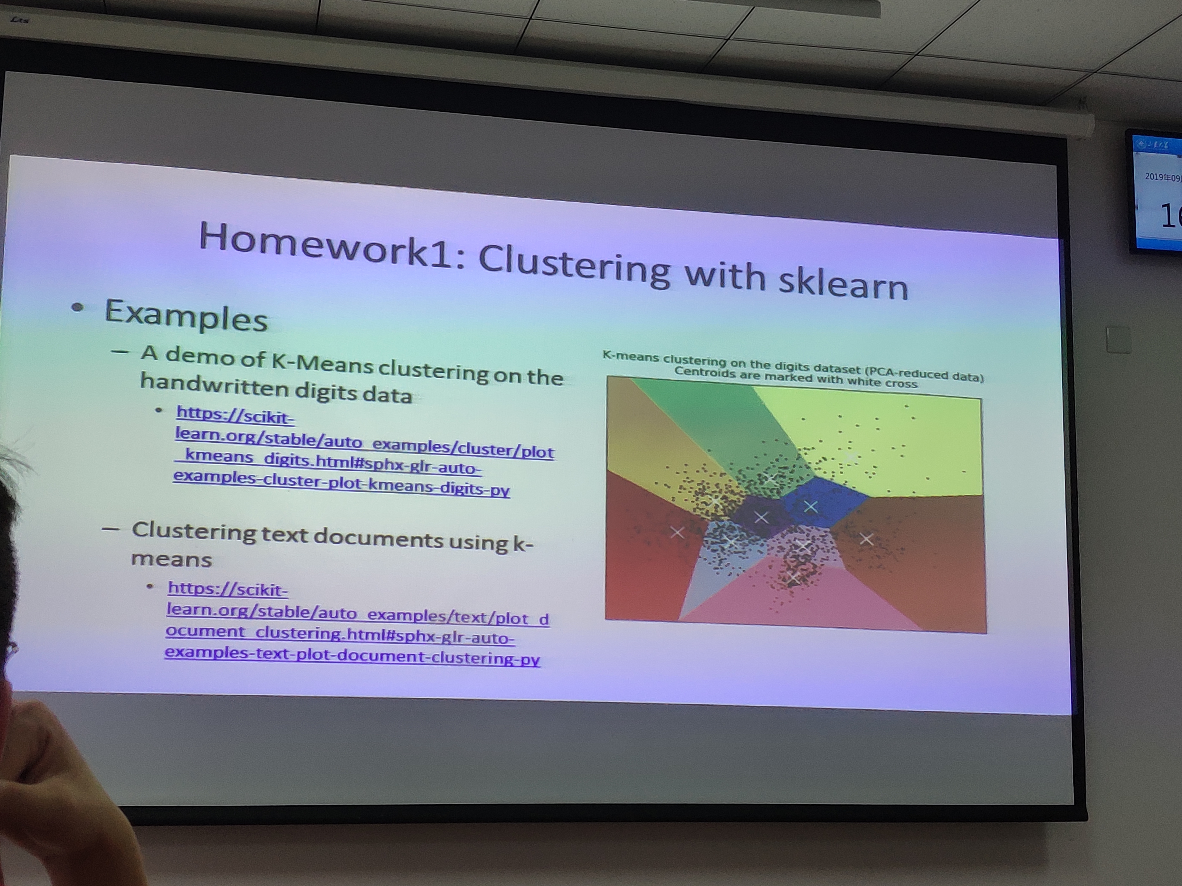

Slide 5
https://scikit-learn.org/stable/auto_examples/cluster/plot_kmeans_digits.html#sphx-glr-download-auto-examples-cluster-plot-kmeans-digits-py

